Slide 1
FINAL PROJECT PRESENTATION
Jaila Acevedo & Stella Ineza Ndahiro

Slide 2
Context
Using Bayesian Inference to determine parameters of a physical model
Applying MCMC sampling method

Slide 3
Part 1: Determining A Bar and Kappa

Slide 4
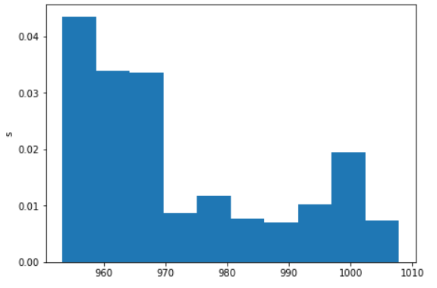
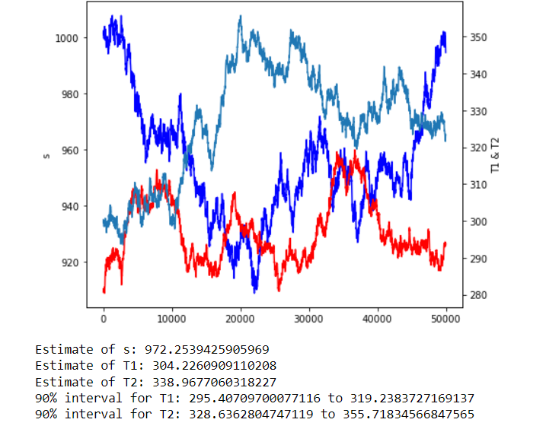
Part 2: Determining S, T1 and T2

